Slide 1

Oman National Qualifications Framework
Development Project
Update May 2016
Fakhriya al Habsi (Director – OQF Department)
Dr Lee Sutherland (Consultant)
Oman Academic Accreditation Authority (OAAA)

Slide 2
OAAA
OQF - Video

Slide 3
Overview
  What is the OAAA mandate regarding the OQF?
  What is a qualification framework?
  Why do we need a qualifications framework for Oman?
  How far have we come?
  How far do we still need to go?
OAAA

Slide 4
OQF Development Project
Background
Overall responsibility for developing and maintaining the Oman Qualifications Framework (OQF) rests with the OAAA (Royal Decree 54/2010)
March 2014 - Education Council issued a decision stating that the OAAA is responsible for developing the OQF which covers academic, vocational, professional and school education.
Planning for the Education Strategy 2040 highlighted the importance of having a national QF for Oman
The MoE/World Bank Report in 2012 also called for a national qualifications framework to be established in Oman
In 2014, the MoE approached the Scottish Qualifications Authority to be an external partner in developing the OQF.

Slide 5
What is a Qualifications Framework?
OAAA
National system for classifying all qualifications
Over 150 countries in the world have a qualification framework of some type
Best known ones are UK, Scotland, Australia and New Zealand

Slide 6
What is a Qualifications Framework?
OAAA
Has different levels and credit points
Makes it possible to compare local qualifications across institutions and with international qualifications
Integrates schooling, vocational and higher education in a national framework

Slide 7
Current Qualifications Framework
OAAA
Post Secondary Schooling
 | Level | Credit Points (Minimum) | Credit Hours (Minimum) | Minimum study duration | Awarded certificate/ level
Undergraduate studies | Level One | 120 | 30 | 1 year | Certificate
 | Level Two | 240 | 60 | 2 years | Diploma
 | Level Three | 360 | 90 | 3 years | Advanced Diploma
 | Level Four | 480 | 120 | 4 years | Bachelor
 |  | 120 | 30 | One year in level four | Graduate Diploma
Postgraduate Studies | Level Five | 120 | 18 - 30 | One year in level five | Post Graduate Diploma
 |  | 150– 180 | 30-45 | Year to two years after bachelor | Master
 | Level Six | 300 | 75 | Two to four years after Master | Doctorate

Slide 8
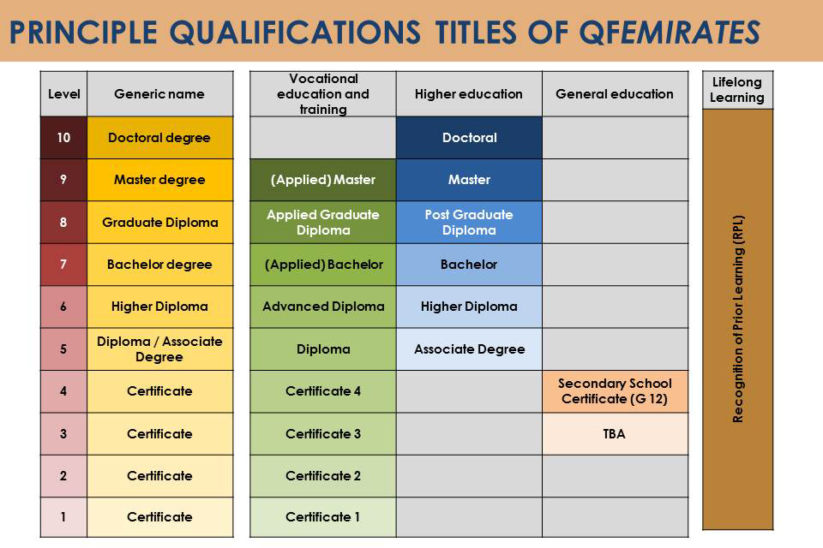

Slide 9


Why do we need National Qualification Framework in Oman?
OAAA
Students, parents and employers will have a clear indication of what qualification holders will know and be able to do at different levels and as a result of different types of education.
Education and training institutions will have a national reference point for curriculum development.
Students and employees will benefit from an OQF which creates access to all types of education, and supports mobility and career pathways between and across institutions and organisations.

Slide 10
Objectives of the OQF
OAAA
Integrate different levels and types of education, such as basic; post-basic; technical education and vocational training and higher education
Facilitate national recognition of acquired skills and knowledge
Organize qualifications into a single comprehensive system of levels, titles and standards
Develop greater parity of esteem between academic and vocational qualifications
Harmonise and enhance quality standards across the system
Encourage lifelong learning
Provide a system for recognising external qualifications.

Slide 11

Timeframes
OAAA
Project divided into two phases
  Phase 1 – May 2015 – July 2016
  Phase 2 – August 2016 – October 2017

Slide 12

Our Journey
OAAA

Slide 13
Our Starting Point
OAAA
The existing qualifications framework for higher education in place since 2004/5
The OQF Development Project started formally with a Project Launch in May 2015
  Establishment of OQF Oversight Committee (June 2014)
  Joined by Scottish Qualification Authority (May 2015
  Development Team seconded to OAAA (June 2015)

Slide 14
Our Journey
OAAA
Another milestone is completion of the Benchmarking Activity
  7 frameworks
  Omani context
The first milestone was the completion of the Communications and Consultation Strategies and Plans

Slide 15
Our Journey
OAAA
Environmental Scan
Representative sample of qualifications in all sectors in Oman (99)
Visit to Bahrain
September 2015
Part of MoU with Bahrain
Lessons Learnt
Mapping Activity
Close look at a sample of qualifications (19)

Slide 16
Our Journey
OAAA
Consultations with stakeholders
Governance, Management and Implementation framework
Prepared and presented to OAAA Board (24th March 2016)
Presented to Education Council 23 May 2016 – awaiting a decision

Slide 17
Work-in-progress
OAAA
Conceptual Design Framework
Technical Design Framework
Implementation Plan
Training Needs Analysis
OQF Glossary

Slide 18
Our Journey
OAAA
End of Phase 1

Slide 19
The next step of the Journey
OAAA
Start of Phase 2
Policy Development
Systems Development
Capacity Development
Consultation

Slide 20

OAAA
Results of findings to date
Qualification landscape in Oman very diverse – great variation in qualification design and specification in terms of
  Terminology
  Learning time
  Naming of qualifications
  Use of learning outcomes
  Availability of assessment criteria
There are numerous awarding bodies in Oman
Most qualifications are already made up of courses or modules
Many programs do not have exit / terminal learning outcomes or clearly defined progression routes
Some sectors have quality assurance systems that are not documented

Slide 21

OAAA
What we know so far …
Credit based system
Use learning outcomes to measure complexity of learning
Operate on level descriptors
Accept the international standard of 10 hours = 1 credit
Only quality assured programs will be listed on the OQF
Only programs that are assessed will be listed on the OQF
Skills programs of less than one year will be recognised

Slide 22
OAAA
Implications for Decision – makers
Need for new legislation and regulations
Greater cooperation between ministries
Need for national support for the project
Need to embrace change
Need for adequate resourcing

Slide 23
OAAA
What can institutions do in the meantime?
Institutions can prepare themselves by doing the following:
  Start to express your qualifications in terms of
    Total number of learning hours
    Learning outcomes (program and modules)
    Assessment criteria
    Progression routes
Develop and strengthen internal and external quality assurance systems and document them
Where possible, try to align qualifications to the existing OQF

Slide 24
OAAA
Frequent questions and answers
Q: When will implementation of the framework begin?
  We do not have a starting date – it will depend on how quickly policies and procedures can be put in place. Institutions will however be provided with sufficient warning.
Q: Will foreign qualifications have to be listed on the OQF?
  Yes. All qualifications delivered in Oman will be required to be placed on the OQF. This means that the qualification will be listed on at least two frameworks. (The listing on the foreign framework will be taken into account.)

Slide 25
OAAA
Frequent Questions and Answers
Q: Will short courses be included on the OQF?
Yes, it is highly likely that short courses will be included on the OQF. However the minimum value of short courses to listed has not been decided yet. Some countries list as little as 1 credit which is usually the equivalent of 10 hours of learning. This would require a lot of resources. A minimum number of credits will be decided upon based on the resources that are available and the Omani context.
Q: Will qualifications that are no longer in use be included on the OQF?
This is still being discussed and there is no clarification as yet.

Slide 26

OAAA
Questions

Slide 27
The Journey of the Oman National Qualifications Framework
OAAA
“We make the road
by walking"
Brazilian educator
Paolo Freire

